Slide 1
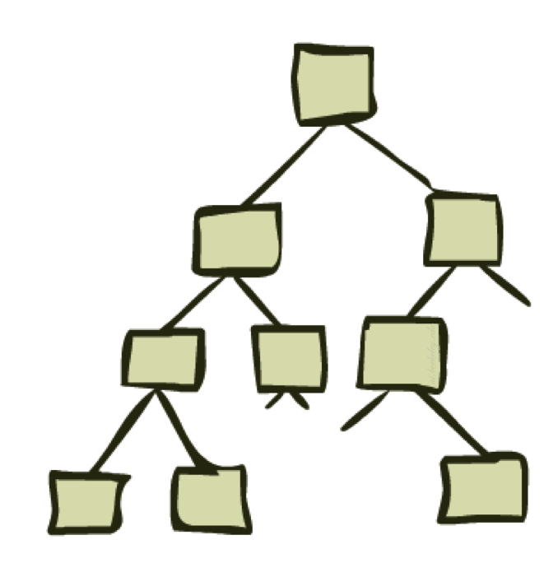
Uninformed Search-II
Depth First Search and its Variants

Slide 2
Previous Lecture
Breadth First Search (BFS)
Depth First Search (DFS)

Slide 3
Depth-Limited Search (DLS)
DFS with a depth bound
Searching is not permitted beyond the depth bound.
Works well if we know what is the depth of the solution.
If the solution is beneath the depth bound, the search cannot find the goal (hence this search algorithm is incomplete).

Slide 4
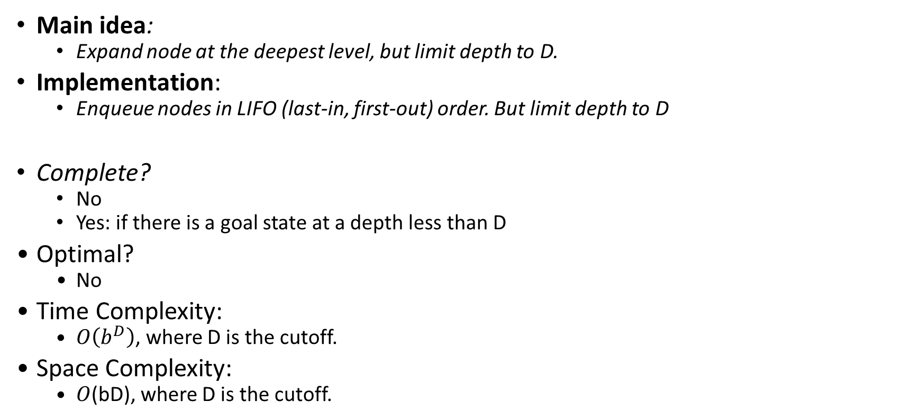
Depth-Limited Search (DLS)
Main idea:
Expand node at the deepest level, but limit depth to D.
Implementation:
Enqueue nodes in LIFO (last-in, first-out) order. But limit depth to D
Complete?
No
Yes: if there is a goal state at a depth less than D
Optimal?
No
Time Complexity:
$O\left(b^{D}\right)$, where D is the cutoff.
Space Complexity:
$O$(bD), where D is the cutoff.

Slide 5
Iterative Deepening Search
To avoid the infinite depth problem of DFS:
Only search until depth L
i.e, don’t expand nodes beyond depth L
Depth-Limited Search
What if solution is deeper than L?
Increase depth iteratively
Iterative Deepening Search
IDS
Inherits the memory advantage of depth-first search
Has the completeness property of breadth-first search

Slide 6
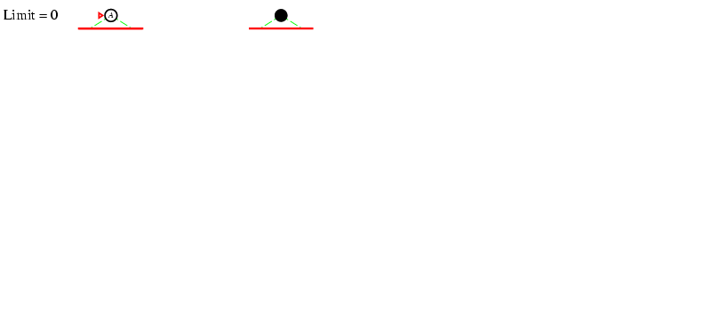
Iterative deepening search l =0
6

Slide 7
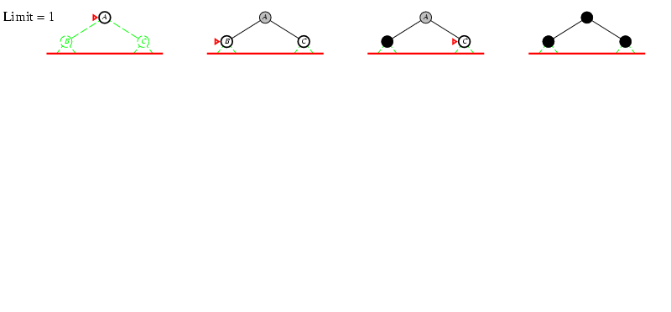
Iterative deepening search l =1
7

Slide 8
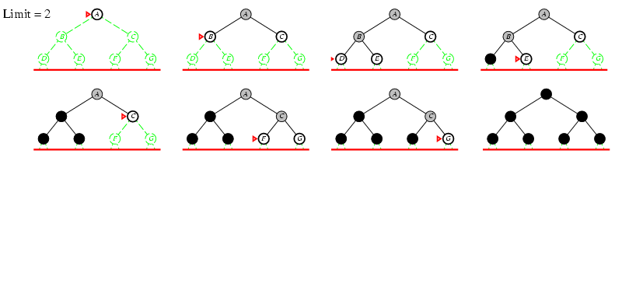
Iterative deepening search l =2
8

Slide 9
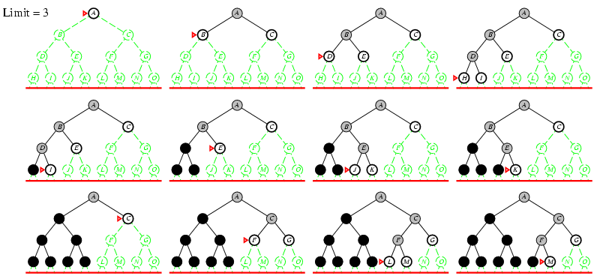
Iterative deepening search l =3
9

Slide 10
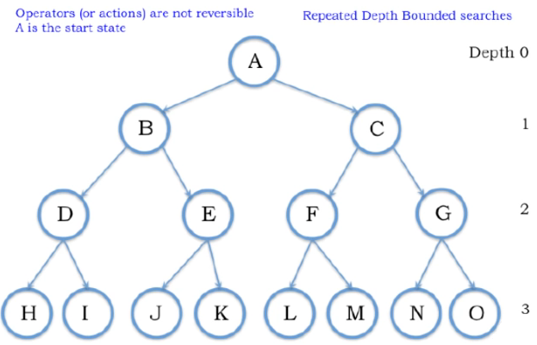

Slide 11
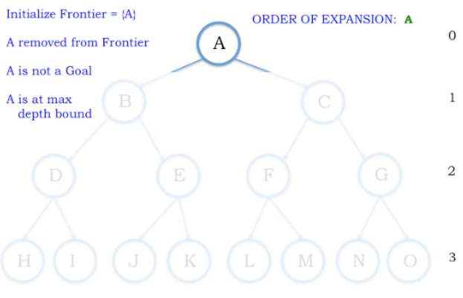
Depth Bound = 0

Slide 12
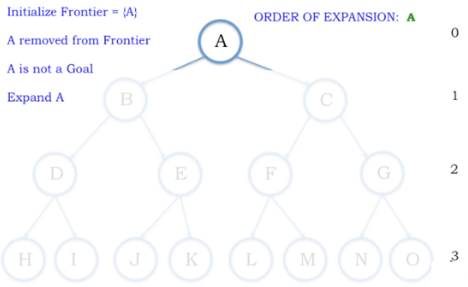
Depth Bound = 1

Slide 13
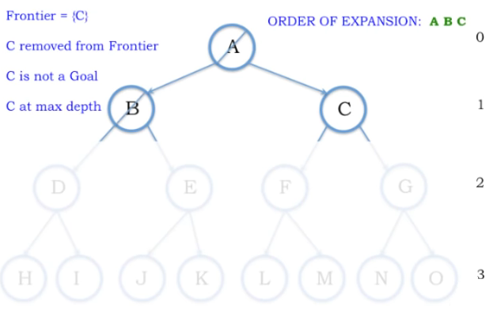
Depth Bound = 1

Slide 14
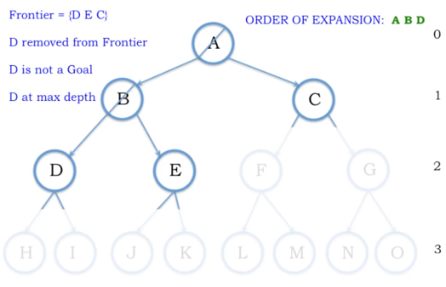

Slide 15
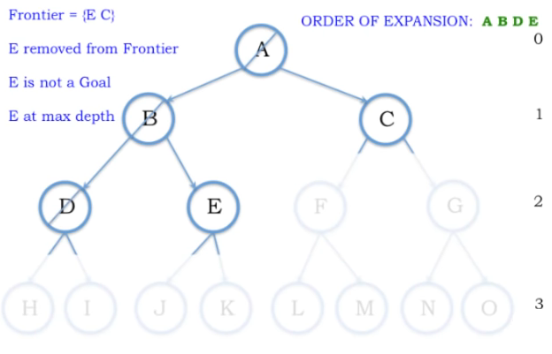

Slide 16
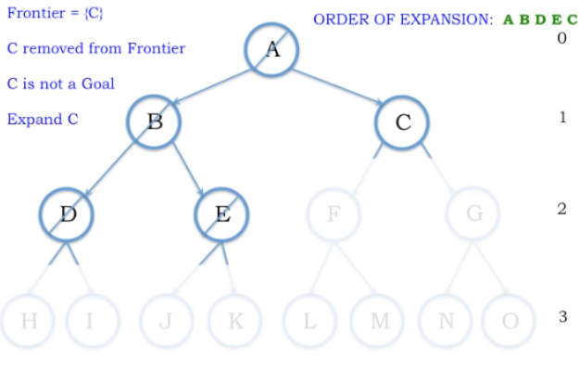

Slide 17
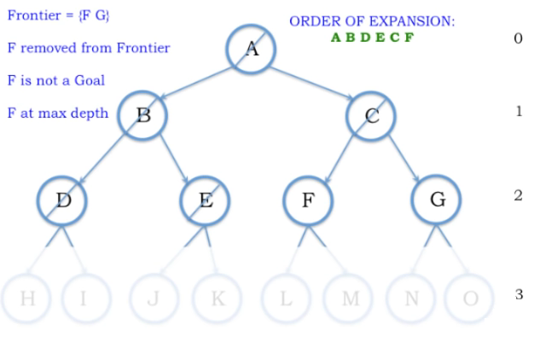

Slide 18
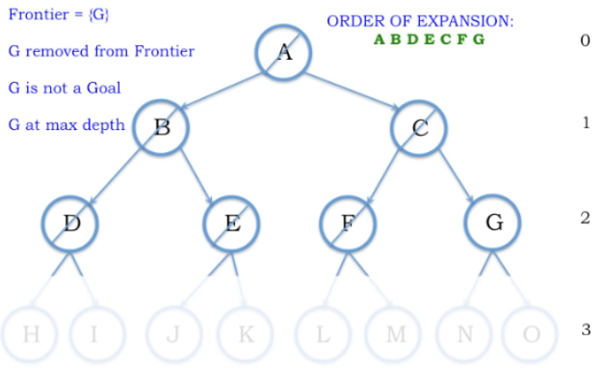
Depth 2

Slide 19
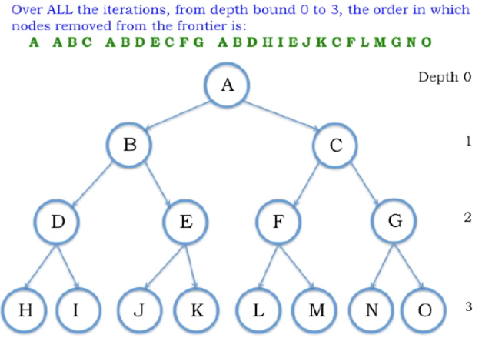

Slide 20
Properties of Iterative Deepening Search
Complete? Yes (in finite spaces)
Time? O(b^{d})
Space? O(bd)
Optimal? Yes, (if step cost = 1 i.e. identical step cost)
20

Slide 21
IDS-Example- Assignment 1
A
D
B
Do it on notebook
Start Node: A
Goal Node: G
Step Frontier Expand[*] Explored: a set of nodes
F
E
C
G
B
G
E

Slide 22
IDS Redundancy
Get DFS’s space advantage with BFS’s time / shallow-solution advantages
Run a DFS with depth limit 1. If no solution…
Run a DFS with depth limit 2. If no solution…
Run a DFS with depth limit 3. …..
Isn’t that wastefully redundant?
Generally most work happens in the lowest level searched, so not so bad!
b
…

Slide 23
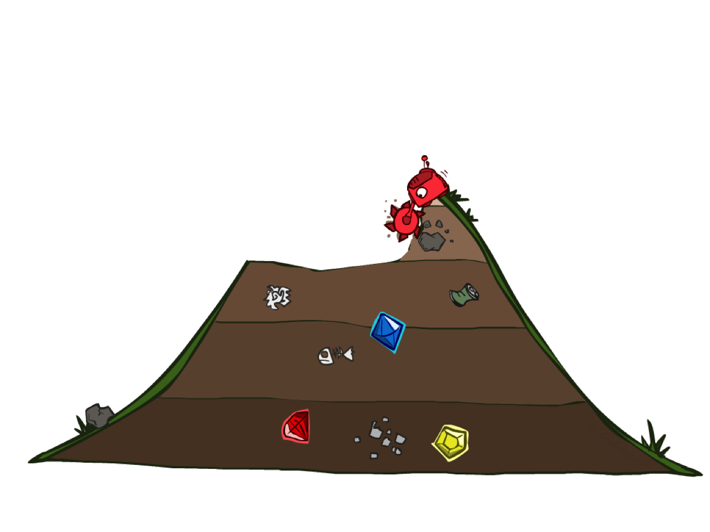
Uniform Cost Search

Slide 24
Uniform Cost Search
Breadth-First Search find the shallowest goal state, but this may not always be the least-cost solution.
Uniform-Cost Search modifies the Breadth-First Search strategy by always expanding the lowest path cost g(n) node on the fringe.
Frontier is a priority queue, i.e., new successors are merged into the queue sorted by g(n).
Can remove successors already on queue w/higher g(n).
Saves memory and time cost.

Slide 25
Uniform Cost Search
2
G
a
Strategy: expand a cheapest node first:
Fringe is a priority queue (priority: cumulative cost)
b
c
1
8
2
2
e
3
d
f
9
8
2
S
h
1
1
p
q
r
15
0
S
d
3
e
9
p
1
b
4
e
5
h
17
r
11
q
16
c
11
Cost contours
a
6
a
h
13
r
7
p
q
f
p
q
f
8
q
c
G
q
c
a
11
G
10
a
Notes:
Like breadth first, but with costs. Label with cumulative cost.
Goal path not victory until try to expanded.
Contours show equal cost.

Slide 26
Uniform Cost Search (UCS)
A
5
2
[5]
B
C
[2]
1
4
1
7
D
[6]
[3]
F
G
[9]
[9]
E
Goal state
4
5
[x] = g(n)
path cost of node n
[7]
H
I
[8]

Slide 27
Uniform Cost Search (UCS)
A
5
2
[5]
B
C
[2]

Slide 28
Uniform Cost Search (UCS)
A
5
2
[5]
B
C
[2]
1
7
[3]
F
G
[9]

Slide 29
Uniform Cost Search (UCS)
A
5
2
[5]
B
C
[2]
1
7
[3]
F
G
[9]
4
5
[7]
H
I
[8]

Slide 30
Uniform Cost Search (UCS)
A
5
2
5
2
[2]
[5]
B
C
[2]
[5]
1
4
1
1
7
7
D
[6]
[3]
F
G
[9]
[3]
[9]
[9]
E
4
5
4
5
[7]
H
I
[8]
[7]
[8]

Slide 31
Uniform Cost Search (UCS)
A
5
2
5
5
2
2
[2]
[2]
[5]
B
C
[2]
[5]
[5]
Goal state path cost g(n)=[6]
1
1
4
1
4
1
1
7
7
7
D
[3]
F
G
[9]
[3]
[3]
[9]
[9]
[9]
[9]
E
4
5
4
4
5
5
[7]
H
I
[8]
[7]
[7]
[8]
[8]

Slide 32
Uniform Cost Search (UCS)
A
5
2
5
5
2
2
[2]
[2]
[5]
B
C
[2]
[5]
[5]
1
1
4
1
4
1
1
7
7
7
D
[6]
[3]
F
G
[9]
[6]
[3]
[3]
[9]
[9]
[9]
[9]
E
4
5
4
4
5
5
[7]
H
I
[8]
[7]
[7]
[8]
[8]

Slide 33
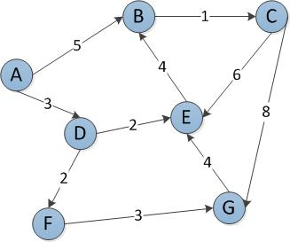
Start Node: A
Goal Node: G
Step Frontier Expand[*] Explored: a set of nodes
1 {(A,0)} A ∅
2 {(A-D,3),(A-B,5)} D {A}
3 {(A-B,5),(A-D-E,5),(A-D-F,5)} B {A,D}
4 {(A-D-E,5),(A-D-F,5),(A-B-C,6)} E {A,D,B}
5 {(A-D-F,5),(A-B-C,6)}[*] F {A,D,B,E}
6 {(A-B-C,6),(A-D-F-G,8)} C {A,D,B,E,F}
7 (A-D-F-G,8)}[+] G {A,D,B,E,F,C}
8 ∅
Found the path: A -> D -> F -> G.
*B is not added to the frontier because it is found in the explored set.
+G and E are not added to the frontier because they are found in explored and frontier

Slide 34
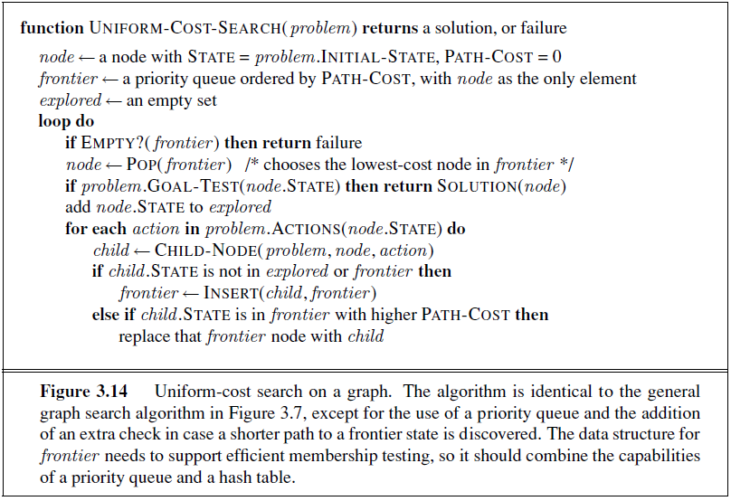
Uniform Cost Search

Slide 35
Uniform Cost Search (UCS) Properties
What nodes does UCS expand?
Processes all nodes with cost less than cheapest solution!
If that solution costs C* and arcs cost at least ε , then the “effective depth” is roughly C*/ε
Takes time O(b^{C*/ε}) (exponential in effective depth)
How much space does the fringe take?
Has roughly the last tier, so O(b^{C*/ε})
Is it complete?
Assuming best solution has a finite cost and minimum arc cost is positive, yes!
Is it optimal?
Yes! (Proof next lecture via A*)
b
c ≤ 1
…
C*/ε “tiers”
c ≤ 2
c ≤ 3

Slide 36
Uniform Cost Issues
…
c ≤ 1
Remember: UCS explores increasing cost contours
The good: UCS is complete and optimal!
The bad:
Explores options in every “direction”
No information about goal location
We’ll fix that soon!
c ≤ 2
c ≤ 3
Start
Goal

Slide 37
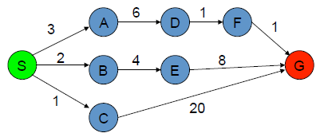
Uniform Cost Search
The graph above shows the step-costs for different paths going from the start (S) to the goal (G).
Use uniform cost search to find the optimal path to the goal.

Slide 38
 | Frontier | Expand | Explored
1 | S | S | Empty
2 | (S-C,1) (S-B,2)(S-A,3) | C | S
3 | (S-B,2)(S-A,3)(S-C-G,21) | B | S,C
4 | (S-A,3)(S-C-G,21)(S-B-E,6) | A | S,C,B
5 | (S-C-G,21)(S-B-E,6)(S-A-D,9) | E | S,C,B,A
6 | (S-C-G,21) (S-A-D,9) (S-B-E-G,14) | D | S,C,B,A,E
7 | (S-B-E-G,14) (S-A-D-F,10) | F | S,C,B,A,E,D
8 | (S-B-E-G,14) (S-A-D-F-G,11) | G | S,C,B,A,E,D,F
9 | S-A-D-F-G,11 Goal Found |  | S,C,B,A,E,D,F,G

Slide 39
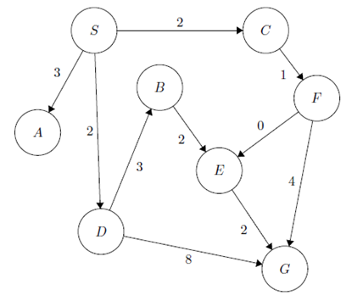
Step | Frontier | Expand | Explored: a set of Nodes
1 | (S,0) | S | Ø
2 | (S-C,2) (S-D,2) (S-A,3) | C | S
3 | (S-D,2) (S-A,3)(S-C-F,3) | D | S,C
4 | (S-A,3)(S-C-F,3)(S-D-B,5)(S-D-G,10) | A | S,C,D
5 | (S-C-F,3)(S-D-B,5)(S-D-G,10) | F | S,C,D,A
6 | (S-D-B,5)(S-D-G,10)(S-C-F-E,3)(S-C-F-G,7) | E | S,C,D,A,F
7 | (S-D-B,5) (S-C-F-G,7) (S-C-F-E-G,5) | B | S,C,D,A,F,E
8 | (S-C-F-E-G,5)* | G | S,C,D,A,F,E,B
9 | (S-C-F-E-G,5) Goal Found

Slide 40
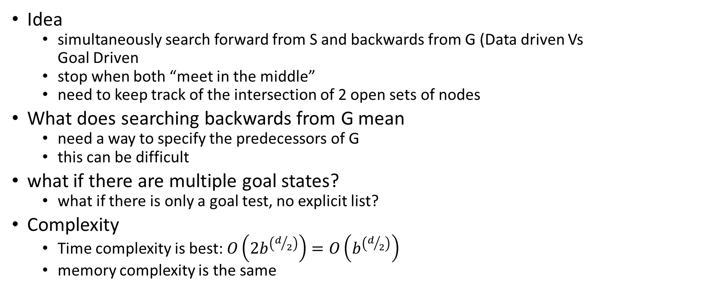
Bidirectional Search
Idea
simultaneously search forward from S and backwards from G (Data driven Vs
Goal Driven
stop when both “meet in the middle”
need to keep track of the intersection of 2 open sets of nodes
What does searching backwards from G mean
need a way to specify the predecessors of G
this can be difficult
what if there are multiple goal states?
what if there is only a goal test, no explicit list?
Complexity
Time complexity is best: $O\left(2b^{\left(d/2\right)}\right)=O\left(b^{\left(d/2\right)}\right)$
memory complexity is the same

Slide 41
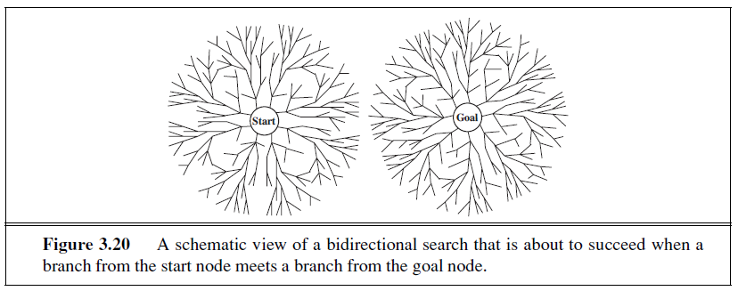
Bidirectional Search

Slide 42
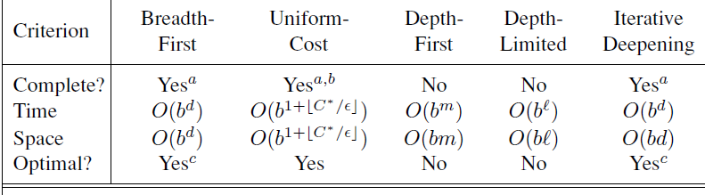
Summary of Algorithms
b branching factor
d depth of the shallowest solution
m maximum depth of the search tree
l depth limit
Superscripts:
a complete if b is finite
b complete if step costs ≥ epsilon for +ve epsilon
c optimal if step costs are all identical
42

Slide 43
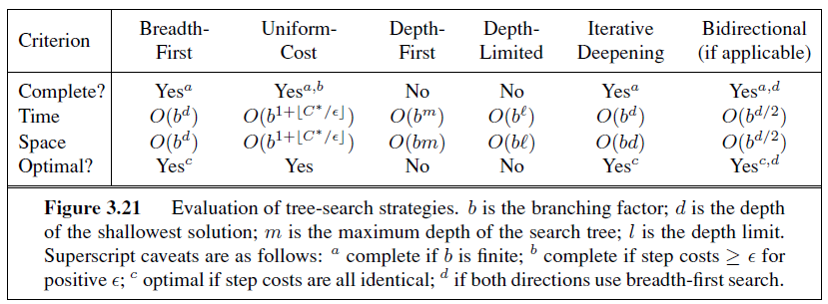
Summary of Algorithms

